Slide 1
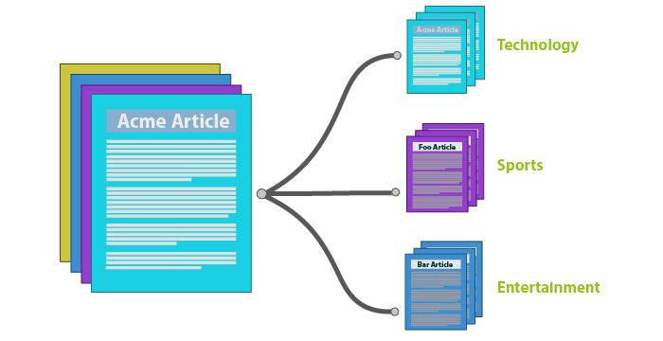
TEXT CLASSIFICATION UISNG MACHINE LEARNING
WITH PYTHON

Slide 2
INTRODUCTION
TEXT CLASSIFICATION
Text Classification is a process of assigning a class or category to the text needed to be processed .
Text Labeling
Sentimental Analysis
Language Detection
Spam Filtering
WHY ?
NLP
NLP or Natural Language Processing is a subset of AI which teaches a machine how to read ,understand and drive meaning from human languages.

Slide 3
PROBLEM AIM
The main goal of this project is to create a machine learning model that will be able to recognize and determine the label / Category of a resume using concepts like NLP and machine learning .

Slide 4
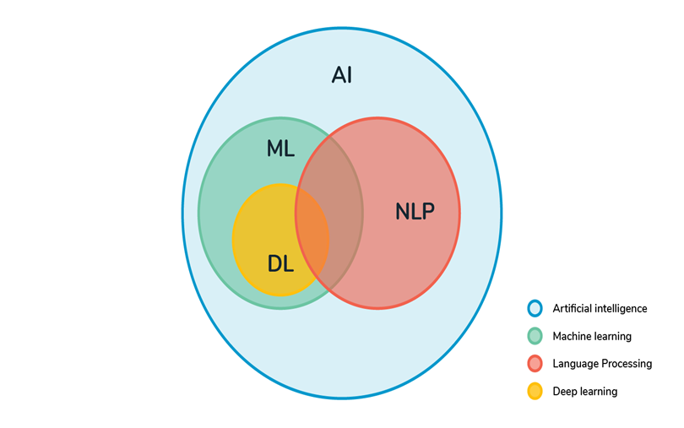
METHODOLOGY
DATA ACQUISITION
DATA VISUALIZATION
TEXT PREPROCESSING
LABEL ENCODING
TEXT VECTORIZATION
MODEL TRAINING
PREDICTION
SERIALIZATION (OPTIONAL)
DEPLOYMENT (OPTIONAL)

Slide 5

1 .DATA MINING

Slide 6
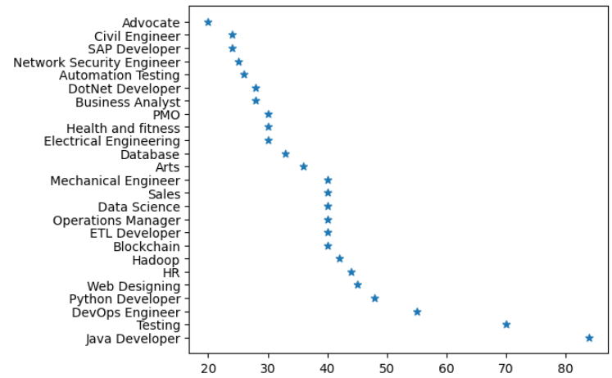
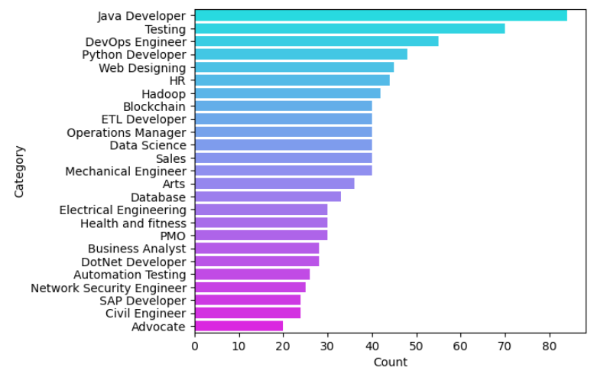
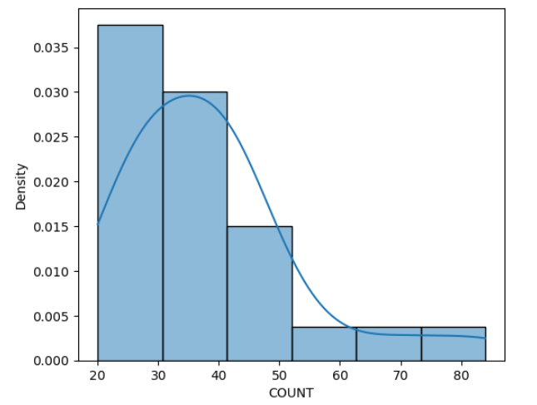
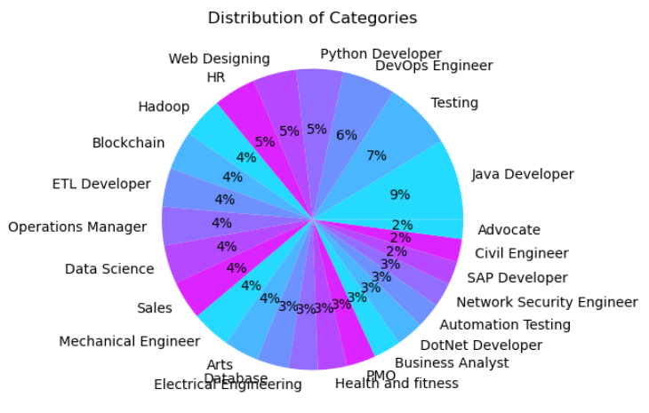
2 .DATA VISUALIZATION
2 | 5

Slide 7
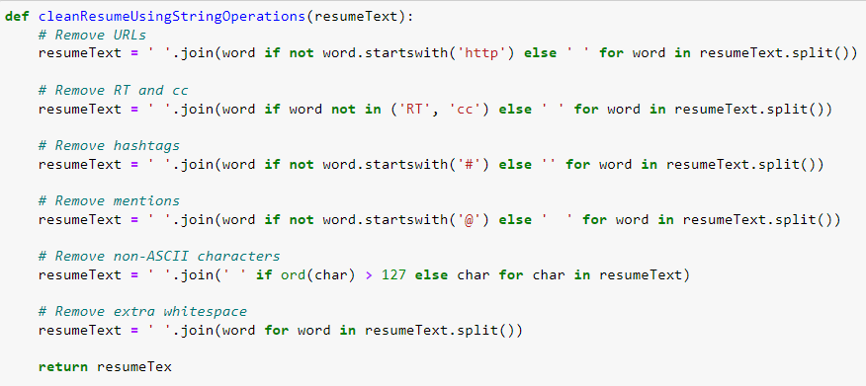
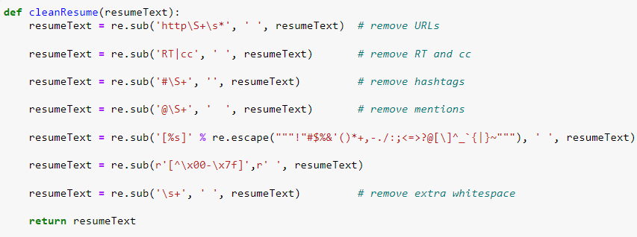
3. TEXT PREPROCESSING

Slide 8
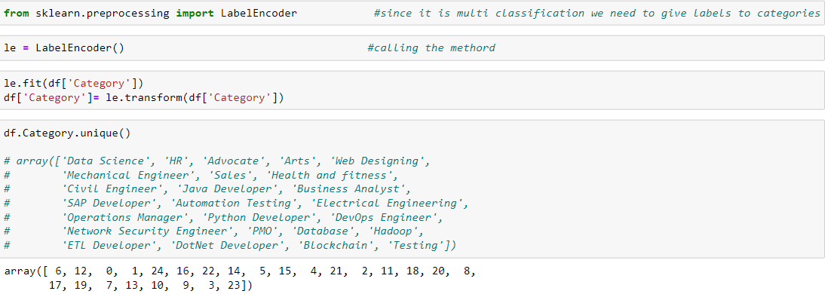
4 . LABEL ENCODING
Since computer cannot understand human language the categories/label used need to be encoded , hence some unique code or number is given to identify the label .

Slide 9
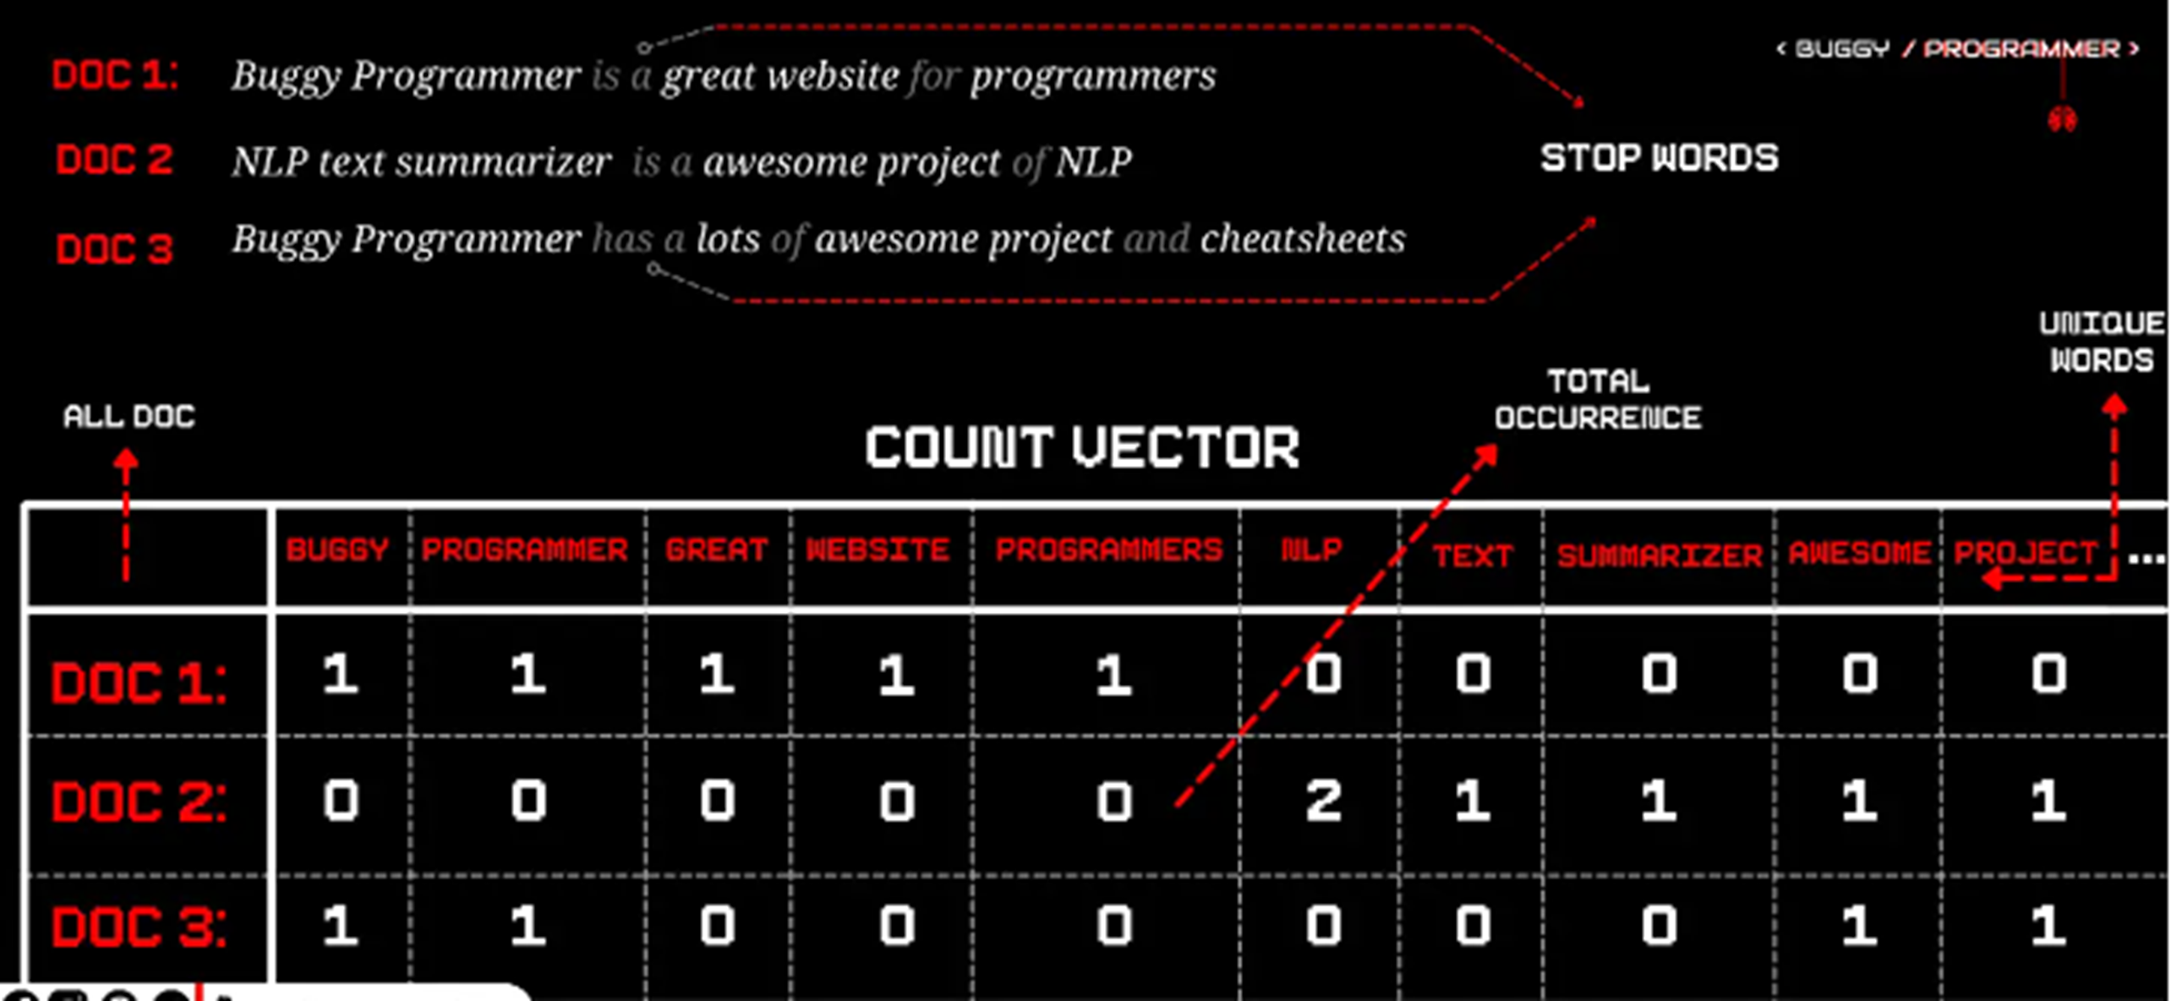
CORPUS .
DOCUMENTS
4 . TEXT VECTORIZATION
VOCABULARY

Slide 10
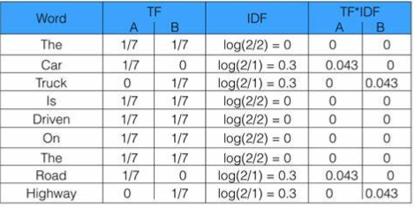
TEXT VECTORIZATION
1
ONE HOT ENCODING
A probabilistic classifier group that uses Bayes' theorem ,It is called naïve because of its assumptions of feature independence.
2
BAG OF WORDS / N-GRAMS
A powerful algorithm that find the categories of data based on the data of K classes nearest to them
3
TF – IDF
The classes are divided by a hyperplane / line which tries to maximize the margin between the support vectors

Slide 11

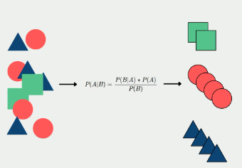
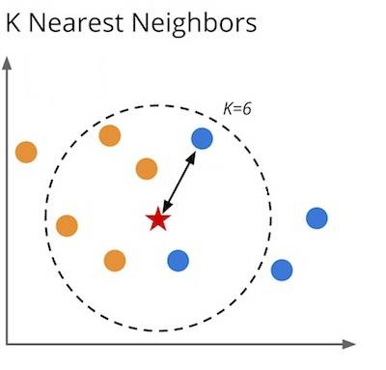
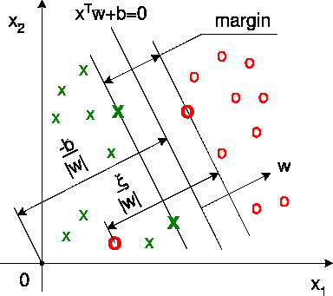
6. MODEL TRAINING
-Popular Machine Learning Algorithms for Text Classification
NAIVE BAYES
K-NN
SVM
A probabilistic classifier group that uses Bayes' theorem
It is called naïve because of its assumptions
That features are independence.
A powerful algorithm that find the categories
of data based on the data of K classes nearest.
The classes are divided by a hyperplane / line
which tries to maximize the margin between the
support vectors
This Photo by Unknown Author is licensed under CC BY-SA

Slide 12
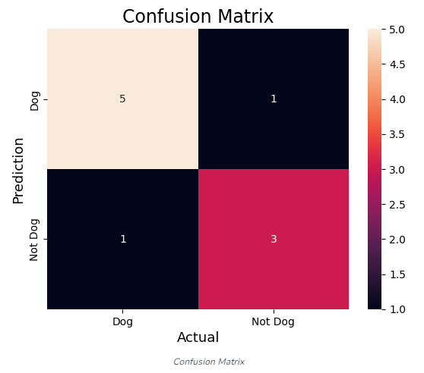
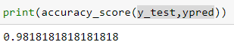
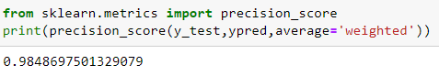
7. PREDICTIONS
Classification matrices are used to evaluate the accuracy .
ACCURACY
MATRIX
CONFUSION MATRIX
.

Slide 13
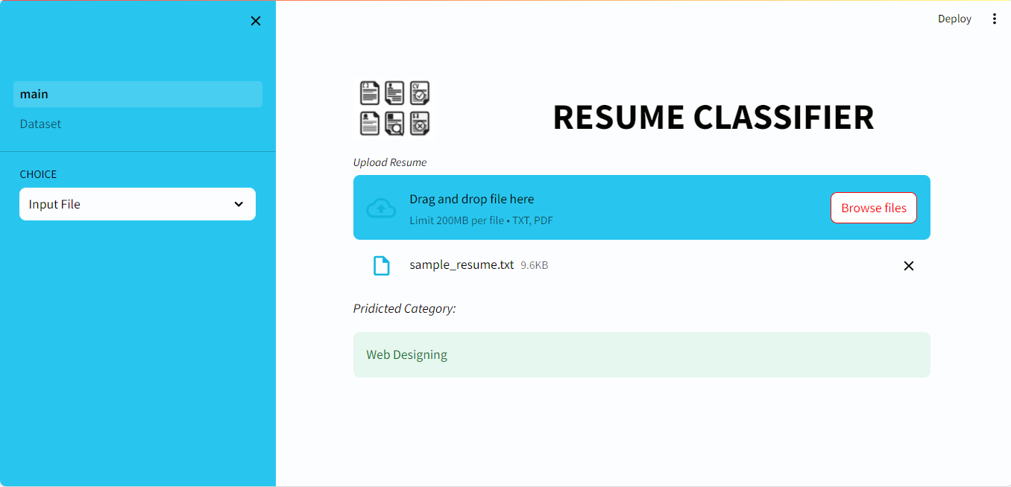
DEPLOYMENT
FUTURE WORK
For future work several factors can be considered :
Dataset : better dataset can be found with more categories present an distributed evenly this will ensure greater accuracy and effectiveness combine with our model.
OOV’s : Although accurate , machine learning algorithms are still susceptible to Out Of Vocabulary ,there are several steps that can be used to reduce OOVs from a model , this wil ensure grater accuracy with the data that our model has never encountered before.
NN : Although accurate , machine learning algorithms are still not as accurate as Neural Network based NLP , so expanding this project to NN will gave greater results.
DATA NAME
DATA NAME
37%
10%
+5 (10%)
-32 (10%)
DATA NAME
DATA NAME
67%
12%
60%
+25%
+5 (10%)
-22 (10%)

Slide 14
THANK YOU

